Slide 1

COMPUTER NETWORKING
LAB 1

Slide 2
Introduction to eNSP

Slide 3
OBJECTIVES
Set up and navigate the eNSP simulator application.
Establish a simple peer-to-peer network in eNSP.
Perform capture of IP packets using Wireshark within eNSP.

Slide 4
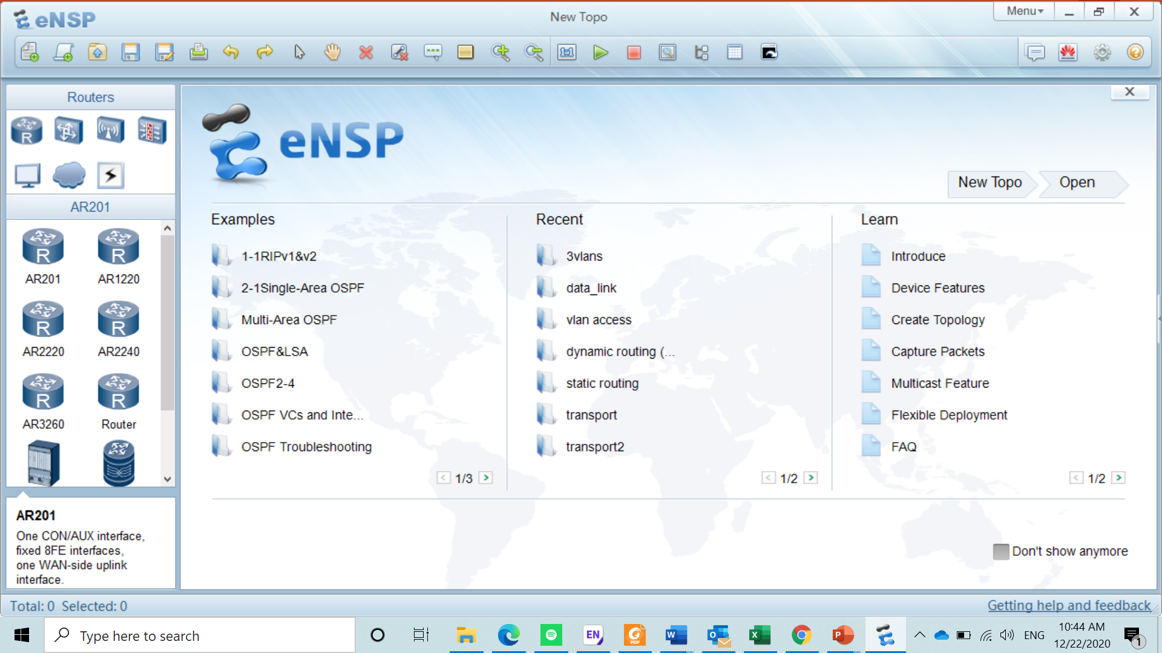
Introduction
eNSP simulator application is a platform for implementation of a network and providing a comprehensive knowledge of IP network.

Slide 5
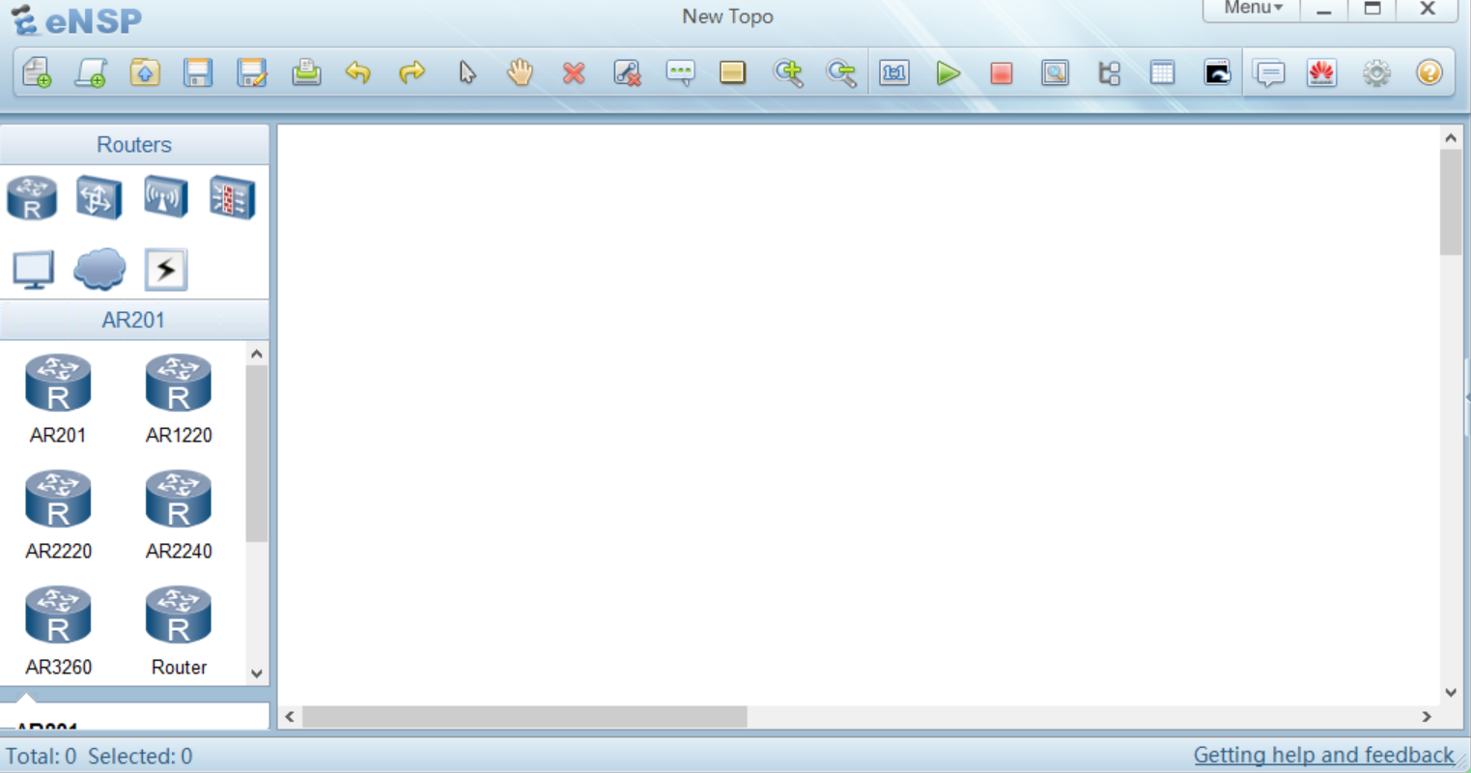
Open saved topology
Print
Delete
All Lines
Start device
New topology
Save
Save as
Write comment
Stop device
Show interfaces

Slide 6
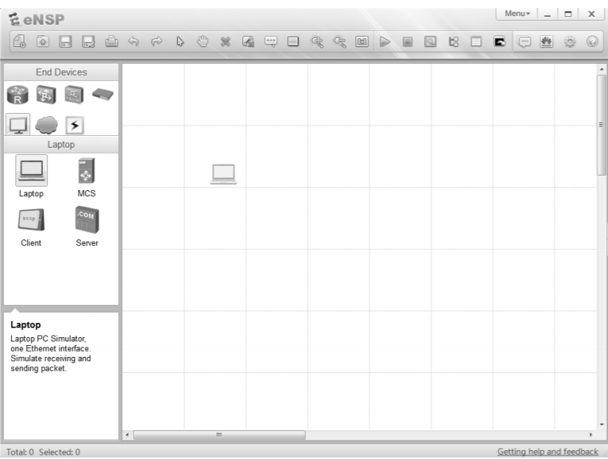
Build a topology
Select the end device icon in the top left panel to reveal a list of end devices that can be applied.
select the laptop icon and drag it to the canvas, release the icon to place it on the canvas.

Slide 7
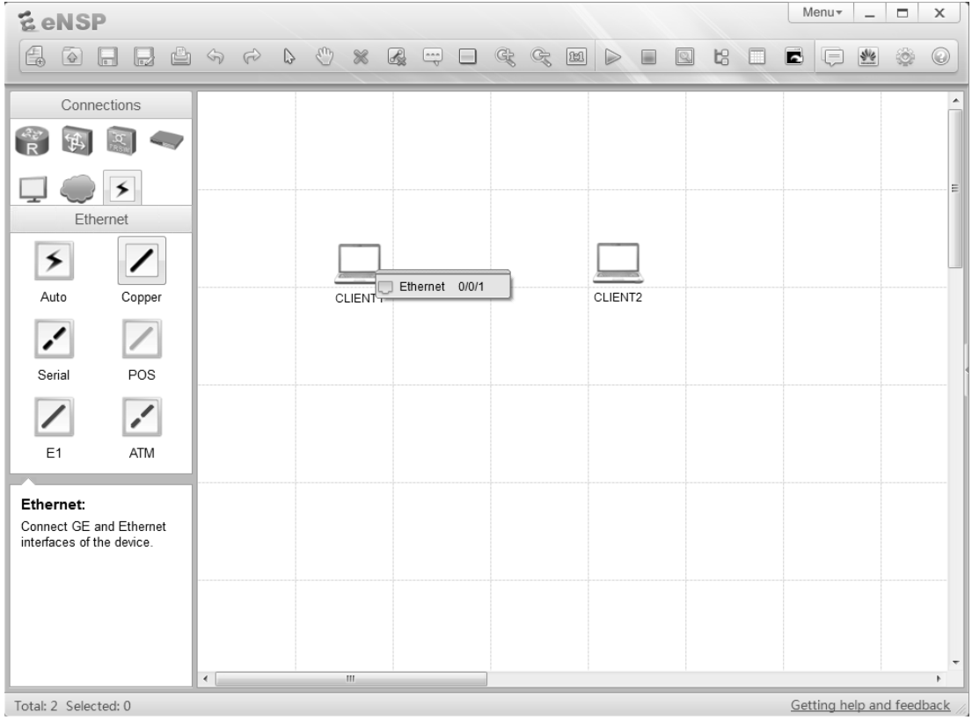
Establish a physical medium
Select the connection icon from the upper left panel to reveal a list of media that can be applied to the topology.
select the laptop icon and drag it to the canvas, release the icon to place it on the canvas.

Slide 8
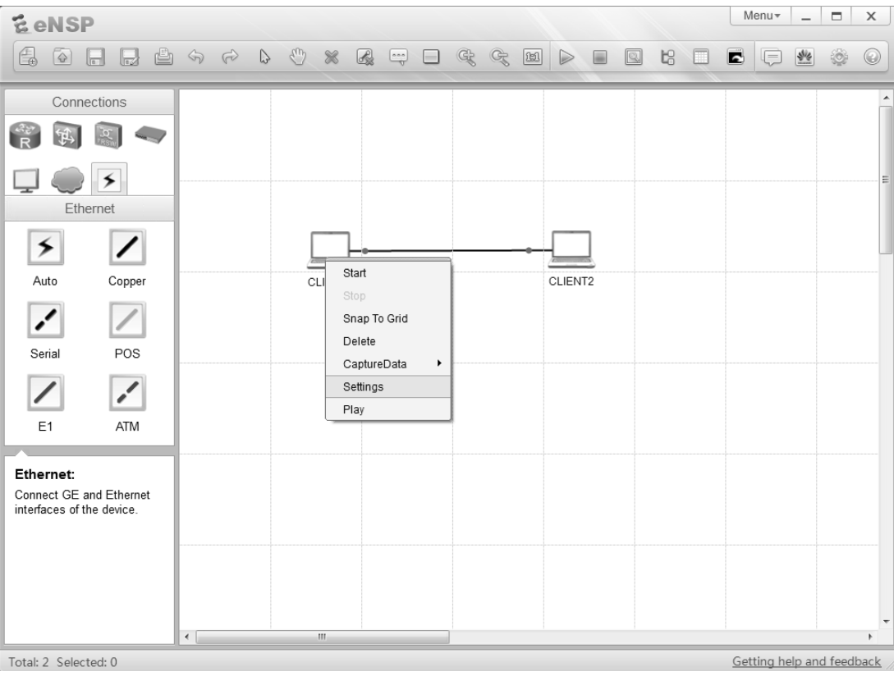
Access End system settings
Select the End system and use the right click to display properties menu
the setting option in the properties window reveals a set of four tabs for establishment of basic configuration.

Slide 9
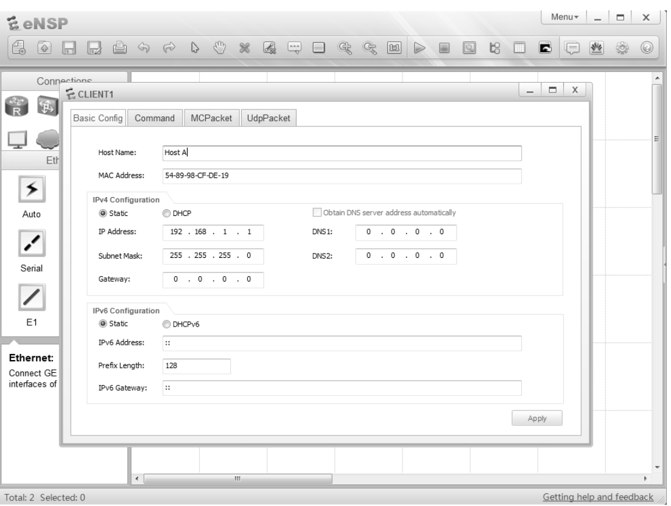
Configure the end system
it is recommended that the address (together with the subnet mask ) configured as shown in the example.

Slide 10
Initiate the end system devices
The devices can be activated using one of two methods.
using right click to open the properties menu and select start for the individual icon or highlight multiple devices.
From the start button on the upper bar.

Slide 11
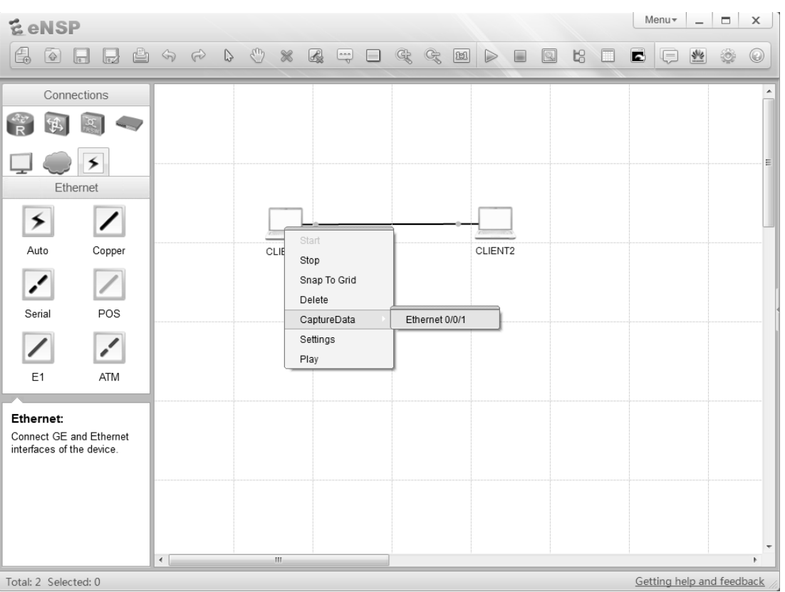
Implement the capture of packets on an interface
Select the device to for whose interface is to be monitored and use the right click option to display the setting menu.
Highlight the capture data option

Slide 12
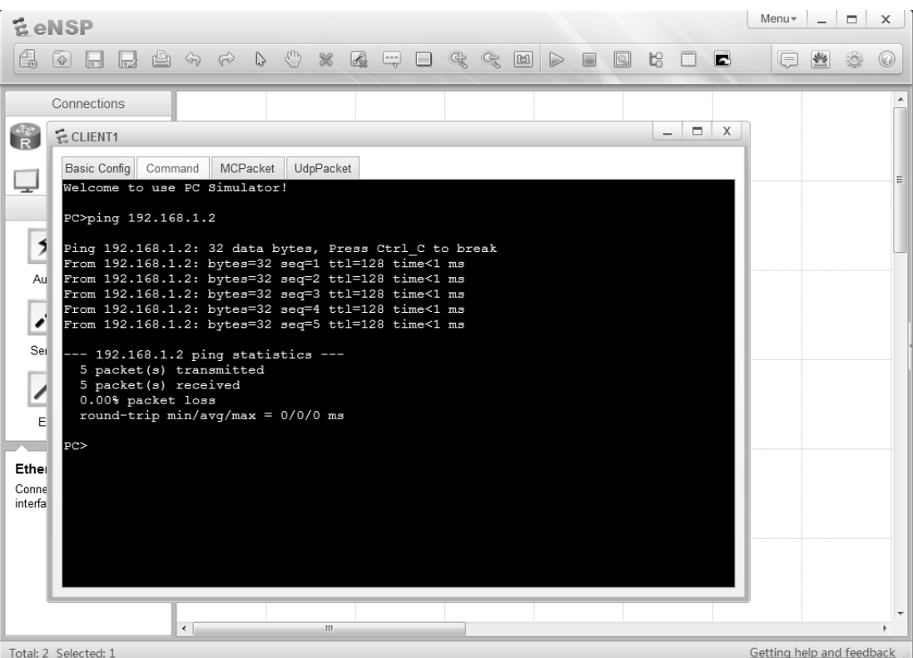
Generate traffic on the interface
The most basic mean for generating traffic is through the ping command.
This can be achieved by entering ping <IP address>

Slide 13
Thank you

